Slide 1
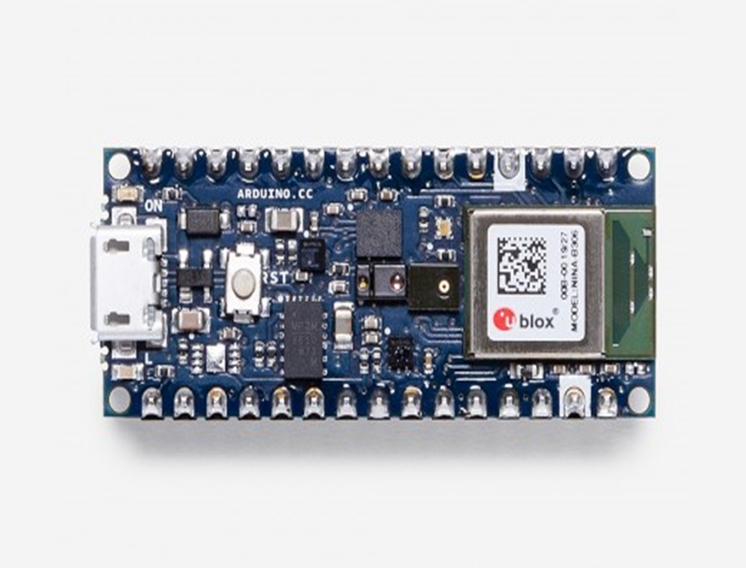
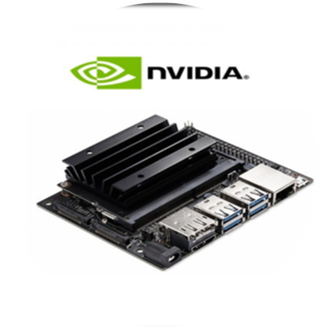
IMAGE processing in JETSoN NANO and tinyml
M PRAVEEN KUMAR(21ECB0B31)
MVS SRIMANTH(21ECB0B33)

Slide 2
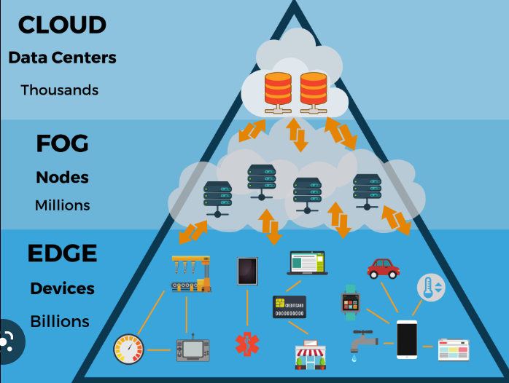
EDGE COMPUTING:
Edge computing is an emerging computing paradigm which refers to a range of networks and devices at or near the user. Edge is about processing data closer to where it’s being generated, enabling processing at greater speeds and volumes, leading to greater action-led results in real time.
It offers some unique advantages over traditional models, where computing power is centralized at an on-premise data center. Putting compute at the edge allows companies to improve how they manage and use physical assets and create new interactive, human experiences. Some examples of edge use cases include self-driving cars, autonomous robots, smart equipment data and automated retail.

Slide 3
ABOUT JETSEN NANO
NVIDIA Jetson Nano Developer Kit is a small, powerful computer that lets run multiple neural networks in parallel for applications like image classification, object detection, segmentation, and speech processing. All in an easy-to-use platform that runs in as little as 5 watts.
It’s simpler than ever to get started! Just inserting a microSD card with the system
image, booting the developer kit, and beginning with the same NVIDIA Jetpack SDK which is
used across the entire NVIDIA Jetson family of products which makes it easy to access a great
small sized computer.
Jetpack is compatible with NVIDIA’s world-leading AI platform for training and deploying AI software, reducing complexity and effort for developers.
However, to make use of the total processing power of the nano there are lot of things to setup for this current application. It is compatible with rasp-camera V2 which will be used in this application

Slide 4
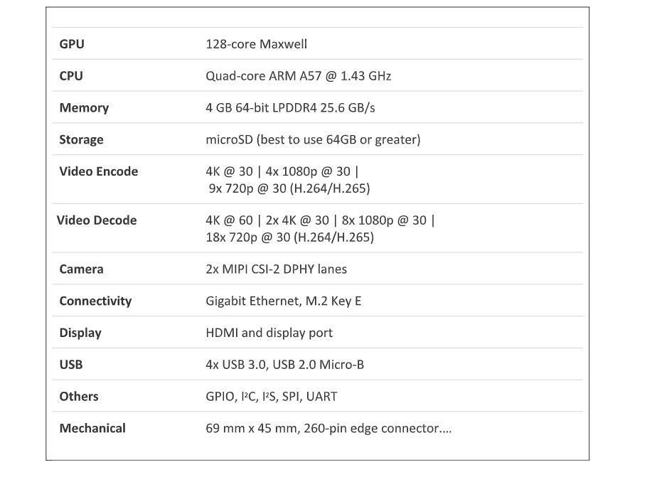
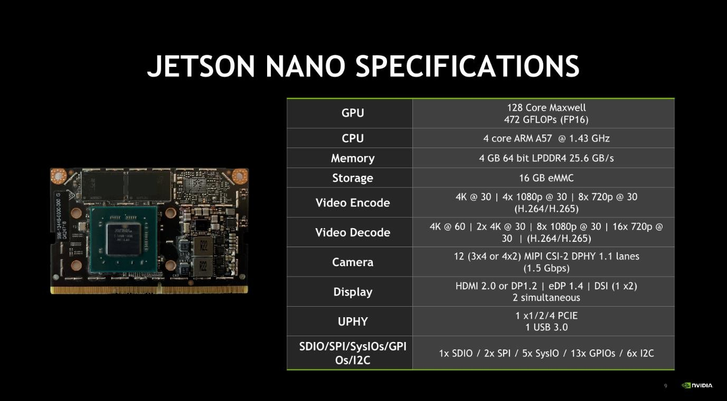
NVIDIA Jetson products provides a SD card image for the complete OS setup of the Jetson-nano that includes Ubuntu 18.04. There is much more customized setup to be done in order to deploy our AI or ML application.

Slide 5
LIBRARIES USED:
­Image and Object Recognition:
Open cv2-version 4.6.0-for model and image capture
Pytorch - to access gpu in jetsan nano
numpy
­TensorFlow
­os python
Histogram and attendance:
Open cv2
Os
PIL
Numpy
Matplotlib
DATA SET USED:
Coco data set
Common Objects in Context
It will have 80 object classes and is have more that 3280000 images in different background and classify 80 objects.
Models used:
1.)ssd mobilenet v3-object detection
2.) harcascade classifier-face detection and image classification
3)LBPH Algorithm

Slide 6

OPEN CV
Computer Vision
Computer vision is a process by which we can understand the images and videos how they are stored and how we can manipulate and retrieve data from them. Computer Vision is the base or mostly used for Artificial Intelligence. Computer-Vision is playing a major role in self-driving cars, robotics as well as in photo correction apps.
OpenCV is the huge open-source library for the computer vision, machine learning, and image processing and now it plays a major role in real-time operation which is very important in today’s systems. By using it, one can process images and videos to identify objects, faces, or even handwriting of a human. When it integrated with various libraries, such as NumPy, python is capable of processing the OpenCV array structure for analysis. To Identify image pattern and its various features we use vector space and perform mathematical operations on these features.

Slide 7
PIL library:
Opening, rotating and displaying an image
To load the image, we simply import the image module from the pillow and call the Image.open(), passing the image filename.
Instead of calling the Pillow module, we will call the PIL module as to make it backward compatible with an older module called Python Imaging Library (PIL). That’s why our code starts with “from PIL import Image” instead of “from Pillow import Image”.
Next, we’re going to load the image by calling the Image.open() function, which returns a value of the Image object data type. Any modification we make to the image object can be saved to an image file with the save() method. The image object we received using Image.open(), later can be used to resize, crop, draw or other image manipulation method calls on this Image object.
OS library:
The OS module in Python provides functions for interacting with the operating system. OS comes under Python’s standard utility modules. This module provides a portable way of using operating system-dependent functionality. The *os* and *os.path* modules include many functions to interact with the file system.

Slide 8

PYTORCH:
PyTorch is a machine learning framework based on the Torch library, used for applications such as computer vision and natural language processing, originally developed by Meta AI and now part of the Linux Foundation umbrella. It is free and open-source software released under the modified BSD license.Used for cuda programming.
COCO DATA SET:
Always remember that for a deep learning or machine learning model to have a good precision, a large dataset is a necessity. So, here’s where our file coco.names comes into picture. COCO stands for Common Objects in Context. This dataset contains objects from an everyday context. It is easier to identify a bottle in front of a blank wall than when it is in a classroom where children are playing hopscotch in the background. COCO dataset provides the labeling and segmentation of the objects in the images. There are 80 object categories of labeled and segmented images in the file. Thus our model can detect and identify 80 types of objects.

Slide 9
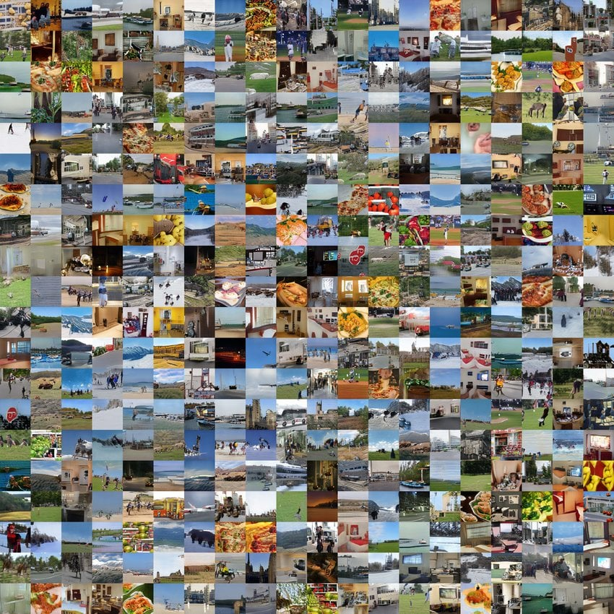
COCO DATASET For object detection: COCO stands for Common Objects in Context, as the image dataset was created with the goal of advancing. The COCO dataset contains challenging, high-quality visual datasets for computer vision, mostly state-of-the-art neural networks.
Features of the COCO dataset
Object segmentation with detailed instance annotations
Recognition in context
Superpixel stuff segmentation
•80 object categories, the “COCO classes”, which include “things” for which individual instances may be easily labeled (person, car, chair, MORE THAN 320000 images are present in the data set and microsoft designed this data set.

Slide 10

What is NumPy?
NumPy is a Python library used for working with arrays. It also has functions for working in domain of linear algebra, fourier transform, and matrices. NumPy was created in 2005 by Travis Oliphant. It is an open source project and you can use it freely. NumPy stands for Numerical Python.
Why Use NumPy?
In Python we have lists that serve the purpose of arrays, but they are slow to process.
NumPy aims to provide an array object that is up to 50x faster than traditional Python lists.
The array object in NumPy is called ndarray, it provides a lot of supporting functions that make working with ndarray very easy.

Slide 11
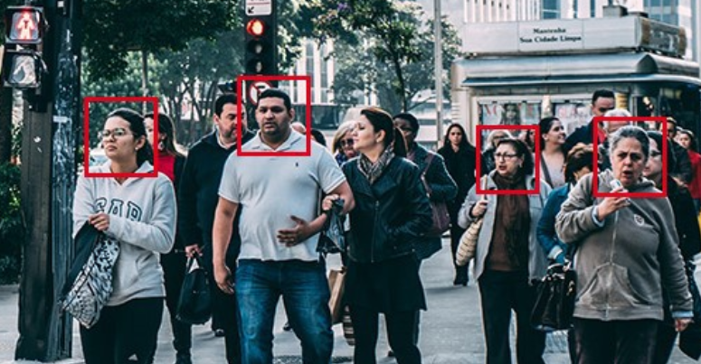
FACE RECOGNITION
Facial recognition is a way of identifying or confirming an individual’s identity using their face. Facial recognition systems can be used to identify people in photos, videos, or in real-time.
Facial recognition is a category of biometric security. Other forms of biometric software include voice recognition, fingerprint recognition, and eye retina or iris recognition. The technology is mostly used for security and law enforcement, though there is increasing interest in other areas of use.
In the past few years, face recognition owned significant consideration and appreciated as one of the most promising applications in the field of image analysis. The method of face detection in pictures is complicated because of variability present across human faces such as pose, expression, position and orientation, skin colour, the presence of glasses or facial hair, differences in camera gain, lighting conditions, and image resolution.

Slide 12
WORKFLOW:
Import images, libraries
Applying haarcascade algorithm
predict the faces
train the model

Slide 13
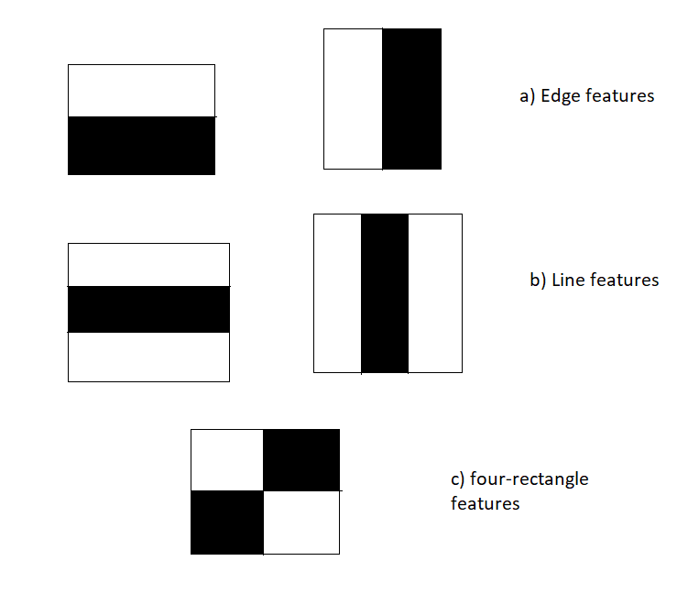
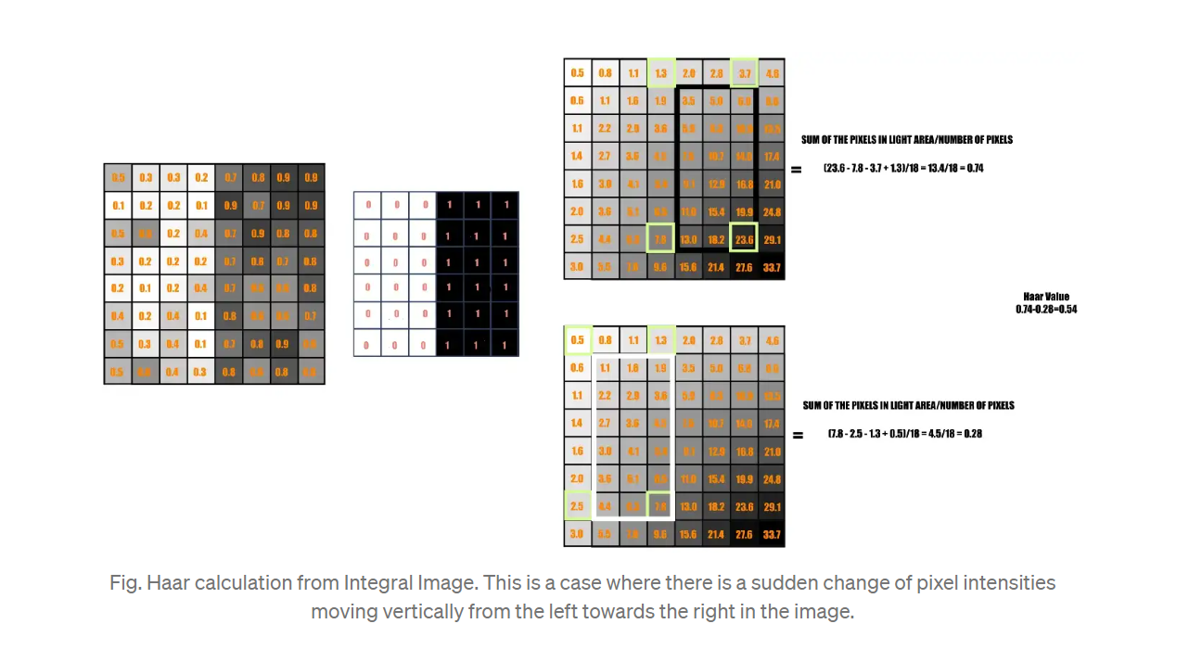
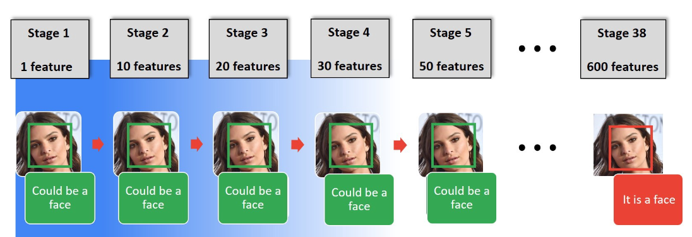
Haar Cascade classifier
It is an Face Detection Algorithm used to identify faces in an image or a real time video. The algorithm uses edge or line detection features proposed by Viola and Jones in their research paper “Rapid Object Detection using a Boosted Cascade of Simple Features” . The algorithm is given a lot of positive images consisting of faces, and a lot of negative images not consisting of any face to train on them.
It works in four stages:
Haar-feature selection: A Haar-like feature consists of dark regions and light regions. It produces a single value by taking the difference of the sum of the intensities of the dark regions and the sum of the intensities of light regions. It is done to extract useful elements necessary for identifying an object. The features proposed by viola and jones are 180000.

Slide 14


Creation of Integral Images: A given pixel in the integral image is the sum of all the pixels on the left and all the pixels above it. Since the process of extracting Haar-like features involves calculating the difference of dark and light rectangular regions, the introduction of Integral Images reduces the time needed to complete this task significantly.
AdaBoost Training: This algorithm selects the best features from all features. It combines multiple “weak classifiers” (best features) into one “strong classifier”. The generated “strong classifier” is basically the linear combination of all “weak classifiers” .It uses boosting technique to classify whether it is a face or not and it is used in ensemble learning.
Cascade Classifier: It is a method for combining increasingly more complex classifiers like AdaBoost in a cascade which allows negative input (non-face) to be quickly discarded while spending more computation on promising or positive face-like regions. It significantly reduces the computation time and makes the process more efficient.
OpenCV comes with lots of pre-trained classifiers. Those XML files can be loaded by cascade Classifier method of the cv2 module. Here we are going to use haarcascade_frontalface_default.xml for detecting faces.
Take each 24x24 window. Apply 6000 features to it.
We are able to achieve 20 fps on jetsan nano.

Slide 15
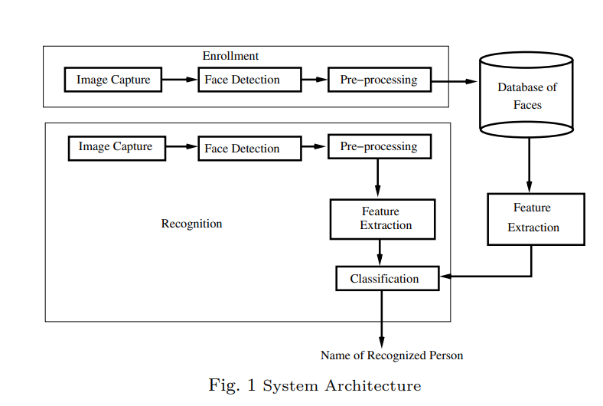
CAPTURING ATTENDANCE USING FACE RECOGNITION:
In many of the educational institutions, managing attendance of students/candidates is tedious, as there would be large number of students in the class and keeping track of all is onerous. There are situations where student act as proxies for their friends even though they are not present. This system, which is based on face detection and recognition algorithms, spontaneously detects the student when he enters the class room and marks the attendance by recognizing him. The database is then modified or updated automatically. This reduces time and effort of manually updating the attendance. This system also provides authentication using recognition of face of the admin or teacher to unlock as there are chances of trespassing by the third party. So this rises the security of the system and it save the time .

Slide 16
Taking pics of faces of the students to be identified and store it in dataset
Feeding that facedata and respective id’s of each face to the recognizer so that it can learn.
Eventually also giving ids to each face
WORKFLOW:
Recognizing students faces standing in front of camera
Update in the excel sheet with roll no. ,name and time

Slide 17
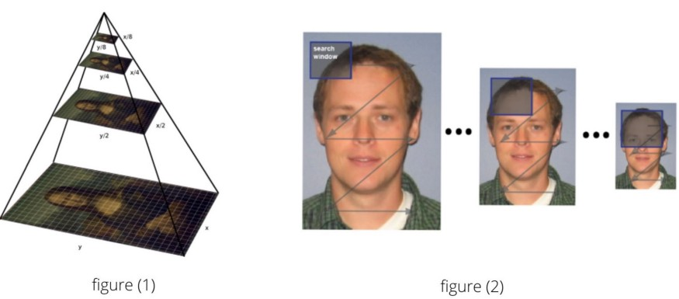
Detect multiscale
We use v2.CascadeClassifier.detectMultiScale() to find faces or eyes, and it is defined like this:
cv2.CascadeClassifier.detectMultiScale( image, scaleFactor, minNeighbors, flags, minSize , maxSize )
Where the parameters are:
image : Containing an image where objects are detected.
scalefactor : Parameter specifying how much the image size is reduced at each image scale.
Since the classifier model was trained with the fixed face size images which can be seen in the xml file. It can detect faces with the same size which was used during the training. So what if our input image has faces smaller or bigger than what was used then. Now, for this reason, we want our image in different scales so that the model can detect a face.

Slide 18
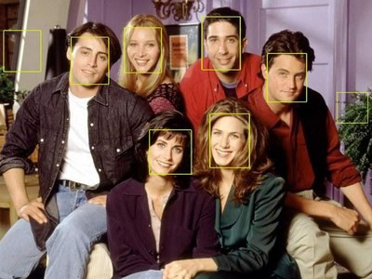
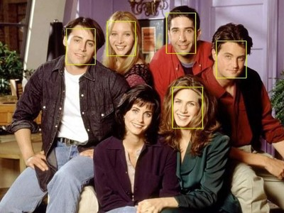
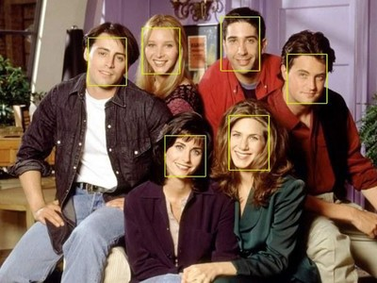
Scale factor =1.05 Means we reduce the image size by 5% each time we scale. This would generate more number of layers since the image is downsized each time by only 5%. With this large number of layers, the algorithm works slower. And since it is more precise the algorithm would take some non-face areas into consideration.
Scale factor =1.8 This large value would generate less number of layers and accordingly the algorithm works faster and can miss some faces.
Scale factor = 1.3 is the value which we take into consideration giving the output as

Slide 19
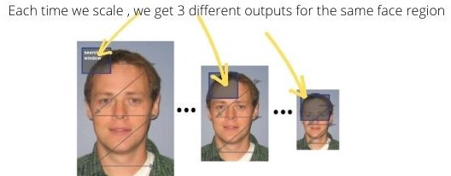
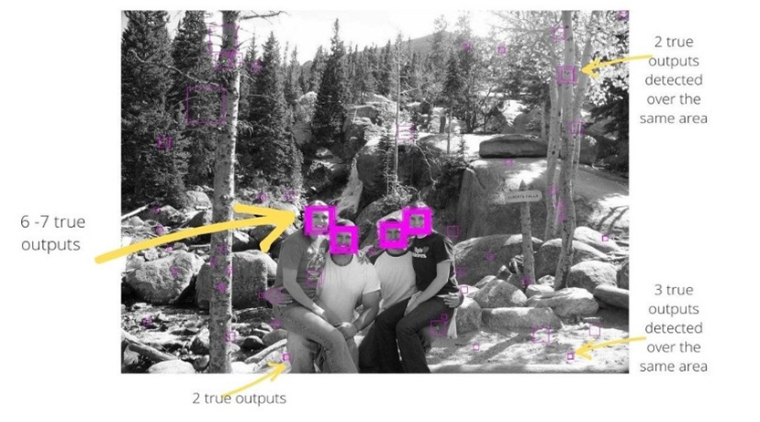
minneighbors : Parameter specifying how many neighbors each candidate rectangle should have to retain it. This parameter will affect the quality of the detected faces: higher value results in less detections but with higher quality. We're using 5 in the code.
Since the object detection works in the combination of the image pyramid (multi-scaling) and sliding window, we get multiple true outputs for a single region of the face. These true outputs are the window region which satisfies the Haar features (could be actual face area or a non-face area taken into consideration).
Therefore, to get an actual face rectangle, the number of rectangles for the same face region must be higher than the minNeighbors.
minNeighbor = 0. In the figure below some areas have multiple true outputs.

Slide 20
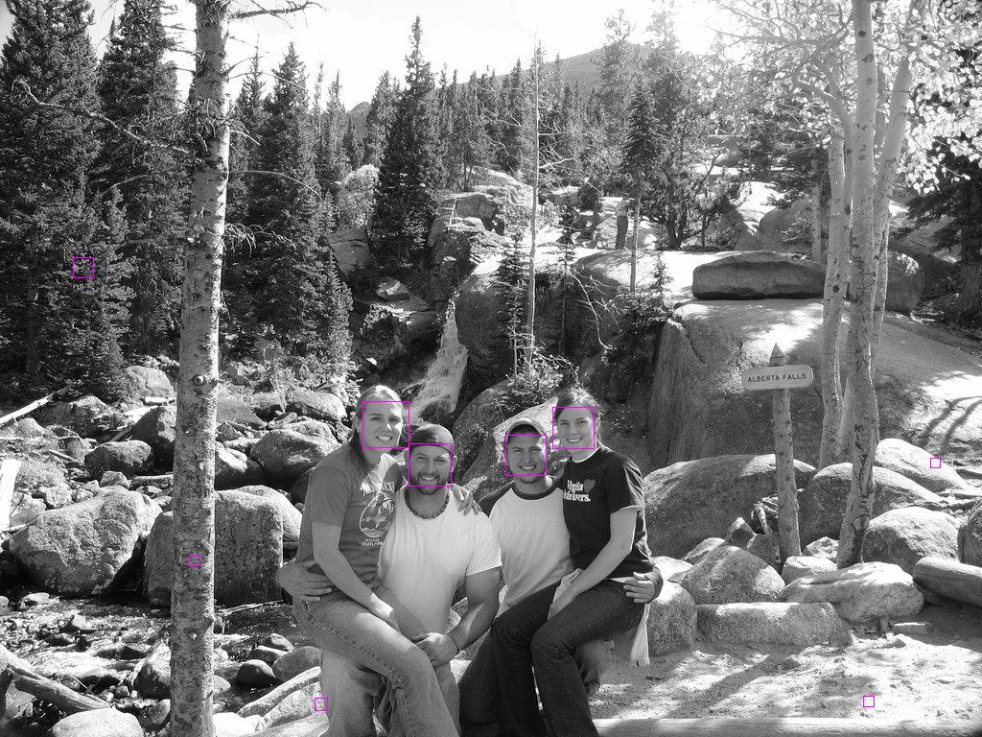
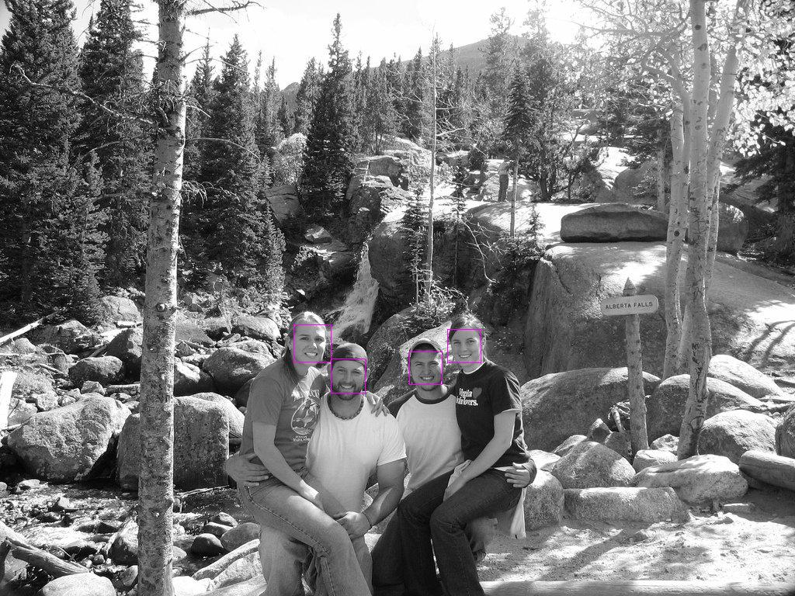
Setting minNeighbor = 3, the area with less than 3 true outputs will not get detected by the classifier. It also includes non faces too.Since minNeighbor is the threshold value for the number of true outputs required to detect a face.
Setting minNeighbor = 5, the area with less than 5 true outputs will not get detected by the classifier. Since minNeighbor is the threshold value for the number of true outputs required to detect a face.
minSize : Minimum possible object size. Objects smaller than that are ignored.
maxSize : Maximum possible object size. Objects larger than that are ignored.

Slide 21
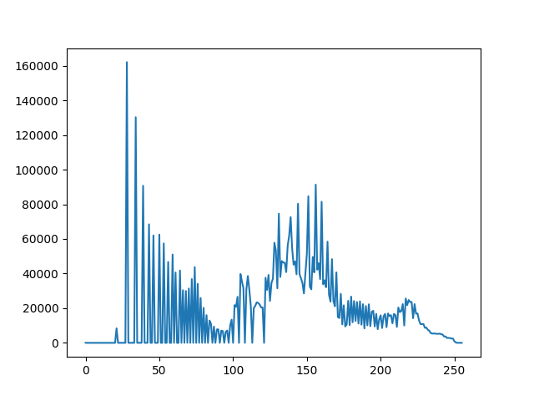
Histogram
Histogram is a graphical representation of the intensity distribution of an image. In simple terms, it represents the number of pixels for each intensity value considered.
In the figure, X-axis represents the total scale (black at the left and white at the right), and Y-axis represents the number of pixels in an image. Here, the histogram shows the number of pixels for each brightness level (from black to white), and when there are more pixels, the peak at the certain brightness level is higher .
USES:
To Remove noise from the images
It is used to analyze an image. Properties of an image can be predicted by the detailed study of the histogram.
It is used for image equalization. Gray level intensities are expanded along the x-axis to produce a high contrast image.
Image processing
The brightness of the image can be adjusted by having the details of its histogram.

Slide 22
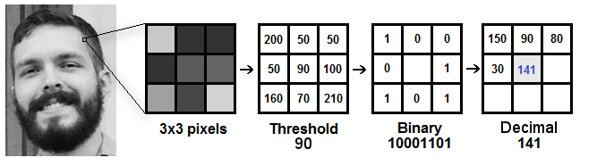
LBPH(Local Binary Patterns Histograms) algorithm
It makes use of a data-set of images of the people to be included in the recognition process. Each image is given a unique ID as either a number or the name of a person so that the algorithm can use this information to identify the image and export the output. The pictures of the same person are always placed under the same ID.
Computational steps:
1) LBP Procedure: Here, an intermediate image has been created to better represent the original image through a sliding window concept, taking into account two parameters: the neighbor and the radius. New values are created in the form of binary by comparing the 8 neighbor values to the threshold value. For each neighbor value greater than the threshold value, the value is set to 1 and 0 for every neighbor value less than the threshold value. This forms a matrix of binary numbers excluding the threshold. A central value of the matrix is created by the conversion of the binary number to a decimal value which corresponds to the pixels of the original image. For a better representation of the characteristics of the original image.

Slide 23
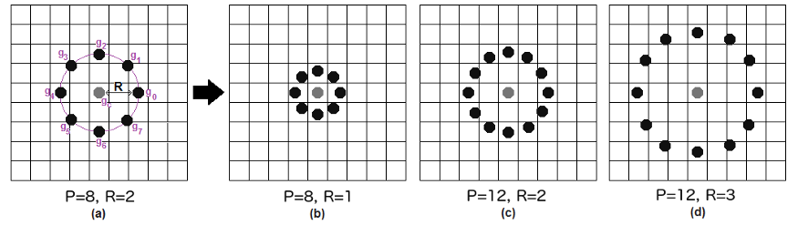
The LBP procedure was expanded to use a different number of radius and neighbors, it is called Circular LBP.

Slide 24
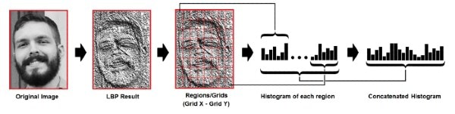
2) To Extract Histograms: The image obtained in step is divided into multiple grids, with the help of the Grid parameters X and Y. This image is in grayscale, each of the histograms of each of the grids is to represent the intensity of the occurrences of each pixel. Each histogram is then combined to create a new histogram that represents the attributes of the original image.
3)Accurate face recognition: Each one made a histogram for an image in the training data set. Two histograms are compared to output the image with the closest histogram matches to an input image. This output is the ID or name of the image.
We can use various approaches to compare the histograms (calculate the distance between two histograms), for example: euclidean distance, chi-square, absolute value, etc.

Slide 25
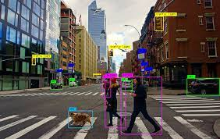
Object Detection
Object detection is a computer technology related to computer vision and image processing that deals with detecting instances of semantic objects of a certain class (such as humans, buildings, or cars) in digital images and videos. Well-researched domains of object detection include face detection and pedestrian detection. Object detection has applications in many areas of computer vision, including image retrieval and video surveillance.
They are extensively used in computer vision tasks like image annotations, face recognition, face detection, object tracking, and many more. Not only that but they are also used to solve real-world problems like Automated CCTV surveillance where you can keep track of some objects that may cause some threats. Objects are tracked until any threat or abnormality is found. It can then be handled by recording the footage for a certain duration and alerting the respective authorities about it.

Slide 26
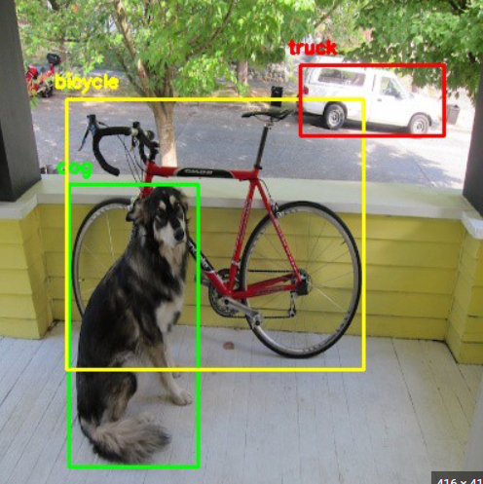
How does object detection work?
Object detection works in a similar way as object recognition. The only difference is that object recognition is the process of identifying the correct object category whereas object detection simply detects the object's presence and location in an image and we are using a kind of transfer learning.
Object detection is a supervised machine learning problem, which means you must train your models on labeled examples.
Object detection tasks can be performed by two different methods of data analysis techniques. They are:
Deep neural network: A deep neural network is generally a supervised learning algorithm that requires large datasets and high GPU computation power to predict object classes. It’s a more accurate way to classify objects which are partially hidden, complex, or placed in unknown backgrounds in an image.
Open cv2 libaries used and mobilnet ssd architecture using mobile net as backbone
Uses ssd (single shot detection):
Using mobilenet v3 ssd
Object detection mainly works by using mobilenet v3 ssd
on the coco data set and predict the bounding boxes in
which the objects are present along with their probability
of occurrence .

Slide 27
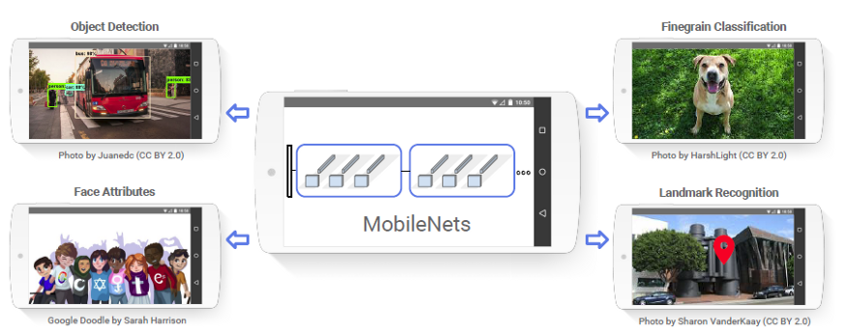
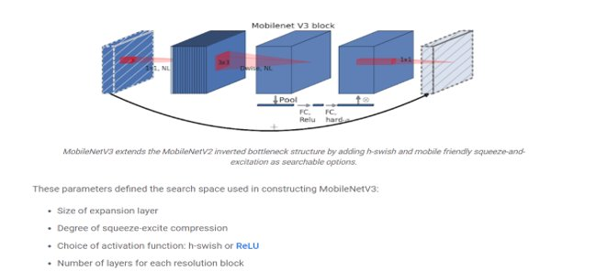
MOBILE NET
MobileNet is an object detector released in 2017 as an efficient CNN architecture designed for mobile and embedded vision application. This architecture uses proven depth-wise separable convolutions to build lightweight deep neural networks. More information about the architecture can be found here.
As the name applied, the MobileNet model is designed to be used in mobile applications, and it is TensorFlow’s first mobile computer vision model.mobilenetv3 was developed by google.
MobileNet uses depthwise separable convolutions. It significantly reduces the number of parameters when compared to the network with regular convolutions with the same depth in the nets. This results in lightweight deep neural networks.
A depthwise separable convolution is made from two operations.
1. Depthwise convolution.
2. Pointwise convolution.
MobileNet is a class of CNN that was open-sourced by Google, and therefore, this gives us an excellent starting point for training our classifiers that are insanely small and insanely fast.

Slide 28
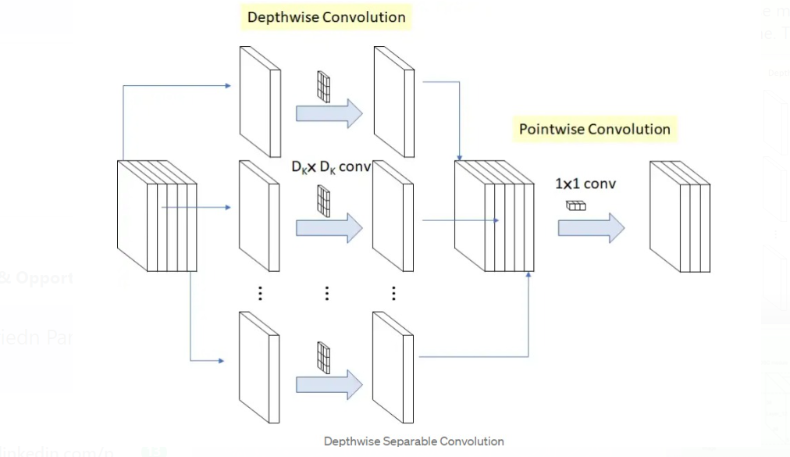
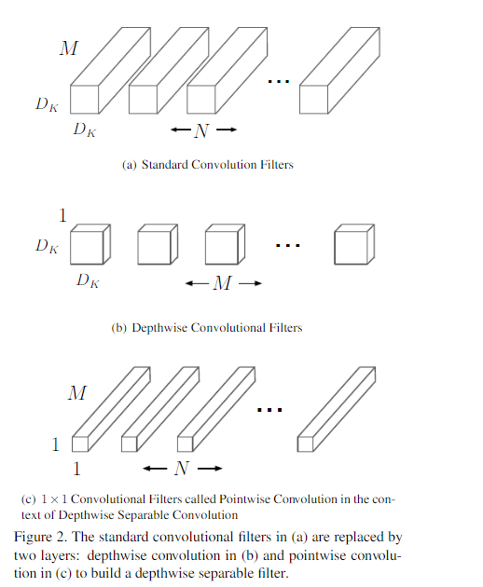
It was released two MobileNet V3 SSDLite models (presented in Searching for MobileNetV3). SSDLite with MobileNet-V3-Large backbone, which is 27% faster than Mobilenet V2 SSDLite (119ms vs 162ms) on a Google Pixel phone CPU at the same mAP. Mobilenet SSD is an object detection model that computes the output bounding box and class of an object from an input image.
POINT WISE AND DEPTHWISE CONVOLUTION:
They reduce the computations that are needed to be performed .
They increase the fastness of prediction by decreasing the number of computations and parameters.

Slide 29
SSD (single shot detector):
The term SSD stands for Single Shot Detector. The SSD technique is based on a forward convolutional network that generates a collection of fixed-size bounding boxes and a score for the presence of object class instances in those boxes, which come behind by a non-maximal suppression step to create the final detections. Fields contain offset values ​​(cx,cy,w,h) from the default field. The score contains confidence values ​​for the presence of each of the object categories, with a value of 0 reserved for the background.
SSD represents multi-reference and multi-resolution detection techniques. Multi-reference techniques define a set of anchor boxes of different sizes and aspect ratios at different locations in the image and then predict a detection box based on these references. Multi-resolution techniques enable object detection at multiple scales and at different network layers. The SSD network implements an algorithm for detecting multiple object classes in images by generating a confidence score related to the presence of any object category in each default field. It also makes adjustments in the boxes to better fit the shapes of the objects. This network is suitable for real-time applications because it does not resample functions for bounding box hypotheses.
MOBILE NET SSD:
Convolutional neural networks are used to develop a model that consists of multiple layers for classifying given objects into one of the defined classes. These objects are detected using higher resolution feature maps made possible by recent advances in deep learning with image processing. Mobilenet SSD is an object detection model that computes the output bounding box and object class from the input image. This Single Shot Detector (SSD) object detection model uses Mobilenet as a backbone and can achieve fast object detection optimized for mobile devices.

Slide 30
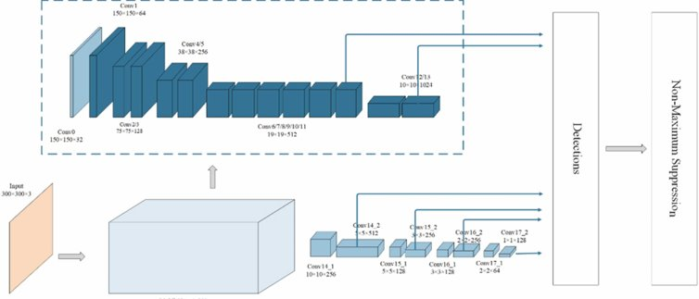
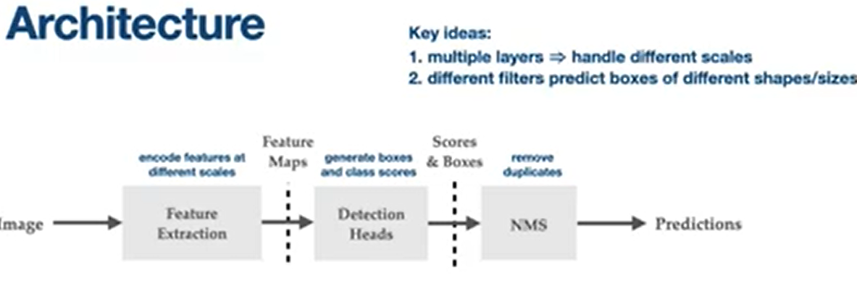
MobileNets are a family of mobile-first computer vision models for TensorFlow, designed to effectively maximize accuracy while being mindful of the restricted resources for an on-device or embedded application.
MobileNets are small, low-latency, low-power models parameterized to meet the resource constraints of a variety of use cases. They can be built upon for classification, detection, embeddings, and segmentation.
As it uses the idea of Depth convolution and point convolution which is different from the normal convolution as done by normal CNNs. This increases the efficiency of CNN to predict images and hence they can be able to compete in the mobile systems as well. Since these ways of convolution reduce the comparison and recognition time a lot, so it provides a better response in a very short time and hence we are using them as our image recognition model.
Mobile nets are light weight neural networks used in mobiles and compute in fast manner.

Slide 31
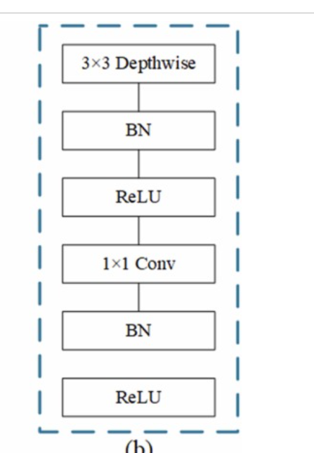
Significance of Frozen inference graph
Freezing is the process to identify and save all of required things(graph, weights etc) in a single file that you can easily use. Frozen graphs are commonly used for inference in TensorFlow .
What does the DetectionModel() do?
It is a deep neural network model that helps in loading a pretrained model, (ssd-mobilenet in our case). The DNN module allows loading pre-trained models of most popular deep learning frameworks, including Tensorflow, Caffe, Darknet, Torch.
What does .zip() and .flatten() do?
It makes a set/list from the values taken by its arguments. The purpose of Python zip() method is to map the similar index of multiple containers so that they can be used just using as single entity. Flattening lists in python means converting multidimensional lists into one-dimensional lists. It is basically a method of merging all the sublists of a nested list into one unified list.

Slide 32
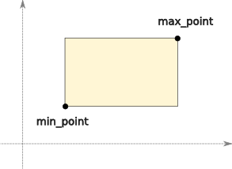
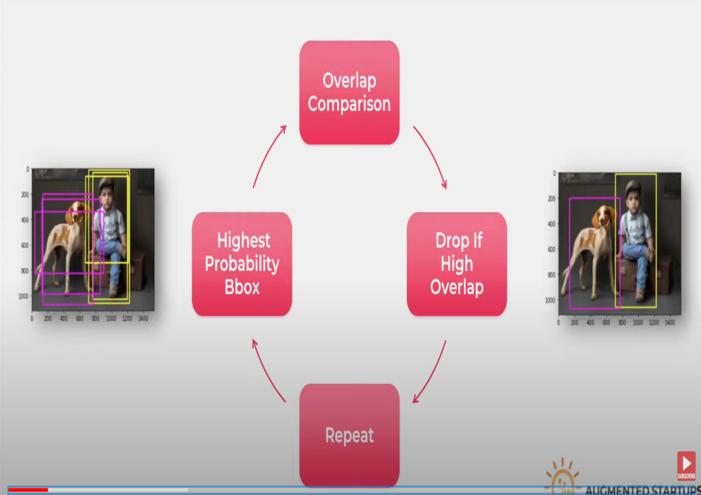
BBOX
You may think it has a error in its spelling ,but it didn’t . The b in bbox is for bounding. Bounding boxes can be useful as standalone shapes, but they are primarily used for approximating more complex shapes to speed operations. It is intended to ease the use of 2D and 3D bounding boxes in areas such as Object Detection by providing a set of flexible primitives and functions that are intuitive and easy to use out of the box.
MOBILENET_SSD__LARGE COCO:
The mobilenet-ssd model is a Single-Shot multibox Detection (SSD) network, intended to perform object detection. In simple words this file is a trained Tensorflow model and has been trained on the COCO dataset.
NON MAX SUPPRESSION:
Non-max suppression is the final step of these object detection algorithms and is used to select the most appropriate bounding box for the object. In this article, I will introduce the concept of non-max suppression, why it is used, and explain how it works in the object detection algorithms.
We are able to achieve 20fps on jetsan nano.
H-swish activation:
The function allows data normalization and leads to quicker convergence and learning of the neural network.

Slide 33
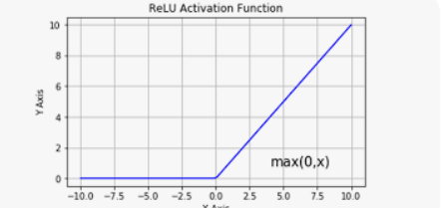
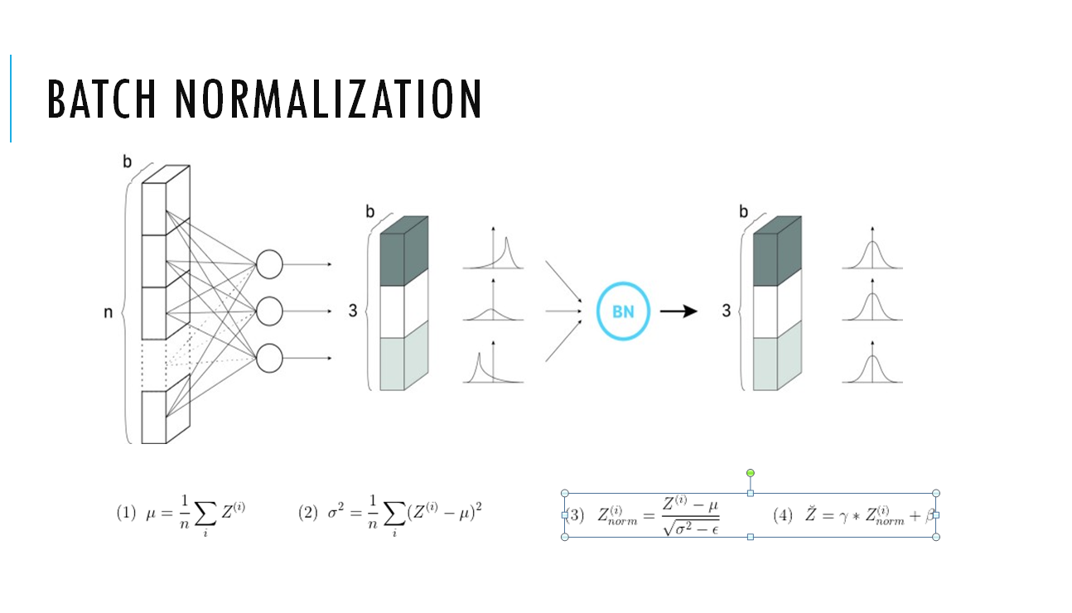
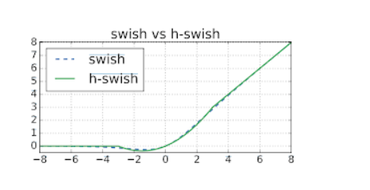
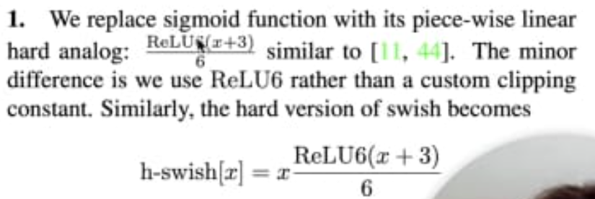

Slide 34
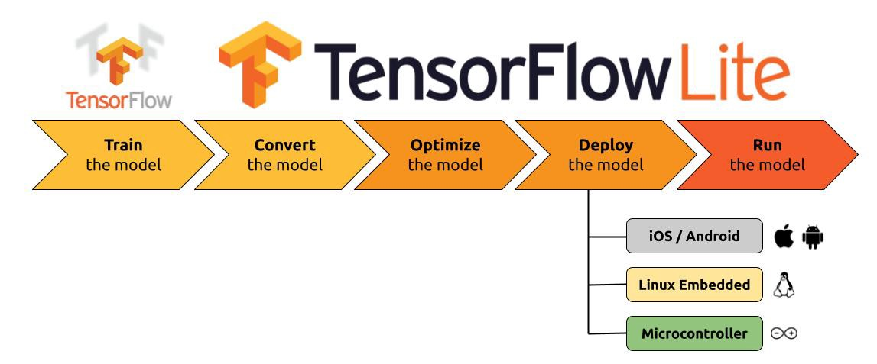
TINY ML
When you say “Alexa” or “Ok, Google”, you want your devices to respond to you instantly. Waiting for the device to send your voice to the servers where it is processed, and the information is retrieved. This takes time and cripples the user experience. Again, in this case, you want the machine learning model to run locally.
Edge computing is a distributed computing paradigm that brings computation and data storage closer to the sources of data. This is expected to improve response times and save bandwidth. It is an architecture rather than a specific technology. It is a topology- and location-sensitive form of distributed computing.
TinyML is a field of study in Machine Learning and Embedded Systems that explores the types of models you can run on small, low-powered devices like microcontrollers. It enables low-latency, low power and low bandwidth model inference at edge devices. While a standard consumer CPUs consume between 65 watts and 85 watts and standard consumer GPU consumes anywhere between 200 watts to 500 watts, a typical microcontroller consumes power in the order of milliwatts or microwatts. That is around a thousand times less power consumption. This low power consumption enables the TinyML devices to run unplugged on batteries for weeks, months, and in some cases, even years, while running ML applications on edge.

Slide 35
Advantages of TinyML
Low Latency: Since the model runs on the edge, the data doesn't have to be sent to a server to run inference. This reduces the latency of the output.
Low Power Consumption: As we discussed before, microcontrollers consume very little power. This enables them to run without being charged for a really long time.
Low Bandwidth: As the data doesn’t have to be sent to the server constantly, less internet bandwidth is used.
Privacy: Since the model is running on the edge, your data is not stored in any servers.
ARDUINO NANO 33 BLE SENSE
The Arduino Nano 33 BLE Sense combines a tiny form factor, different environment sensors and the possibility to run AI using TinyML and TensorFlow™ Lite. Whether you are looking at creating your Bluetooth® Low Energy to connect your project to your phone, the Nano 33 Birst embedded ML application or you want to use LE Sense will make that journey easy.

Slide 36
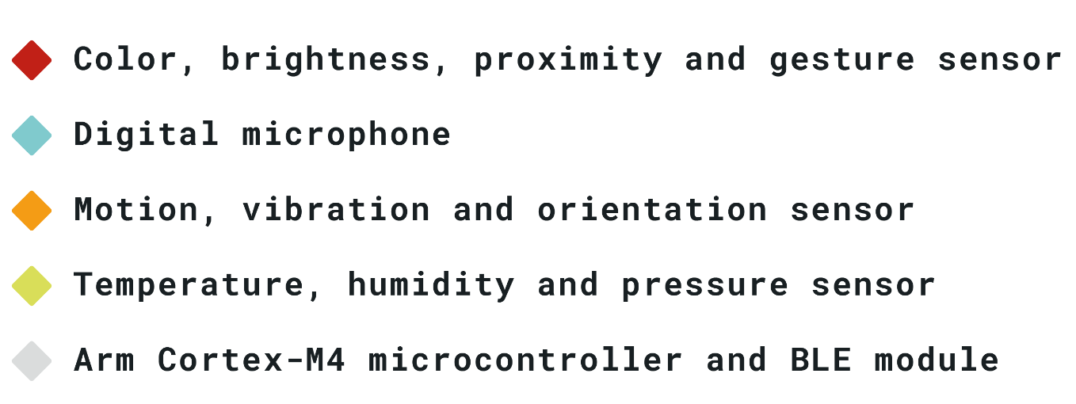
The Arduino Nano 33 BLE is an evolution of the traditional Arduino Nano, but featuring a lot more powerful processor, the nRF52840 from Nordic Semiconductors, a 32-bit ARM® Cortex®-M4 CPU running at 64 MHz. This will allow you to make larger programs than with the Arduino Uno (it has 1MB of program memory, 32 times bigger), and with a lot more variables (the RAM is 128 times bigger). The main processor includes other amazing features like Bluetooth® pairing via NFC and ultra low power consumption modes.
The Nano 33 BLE comes with a 9 axis inertial measurement unit (IMU) which means that it includes an accelerometer, a gyroscope, and a magnetometer with 3-axis resolution each. This makes the Nano 33 BLE the perfect choice for more advanced robotics experiments, exercise trackers, digital compasses, etc.

Slide 37
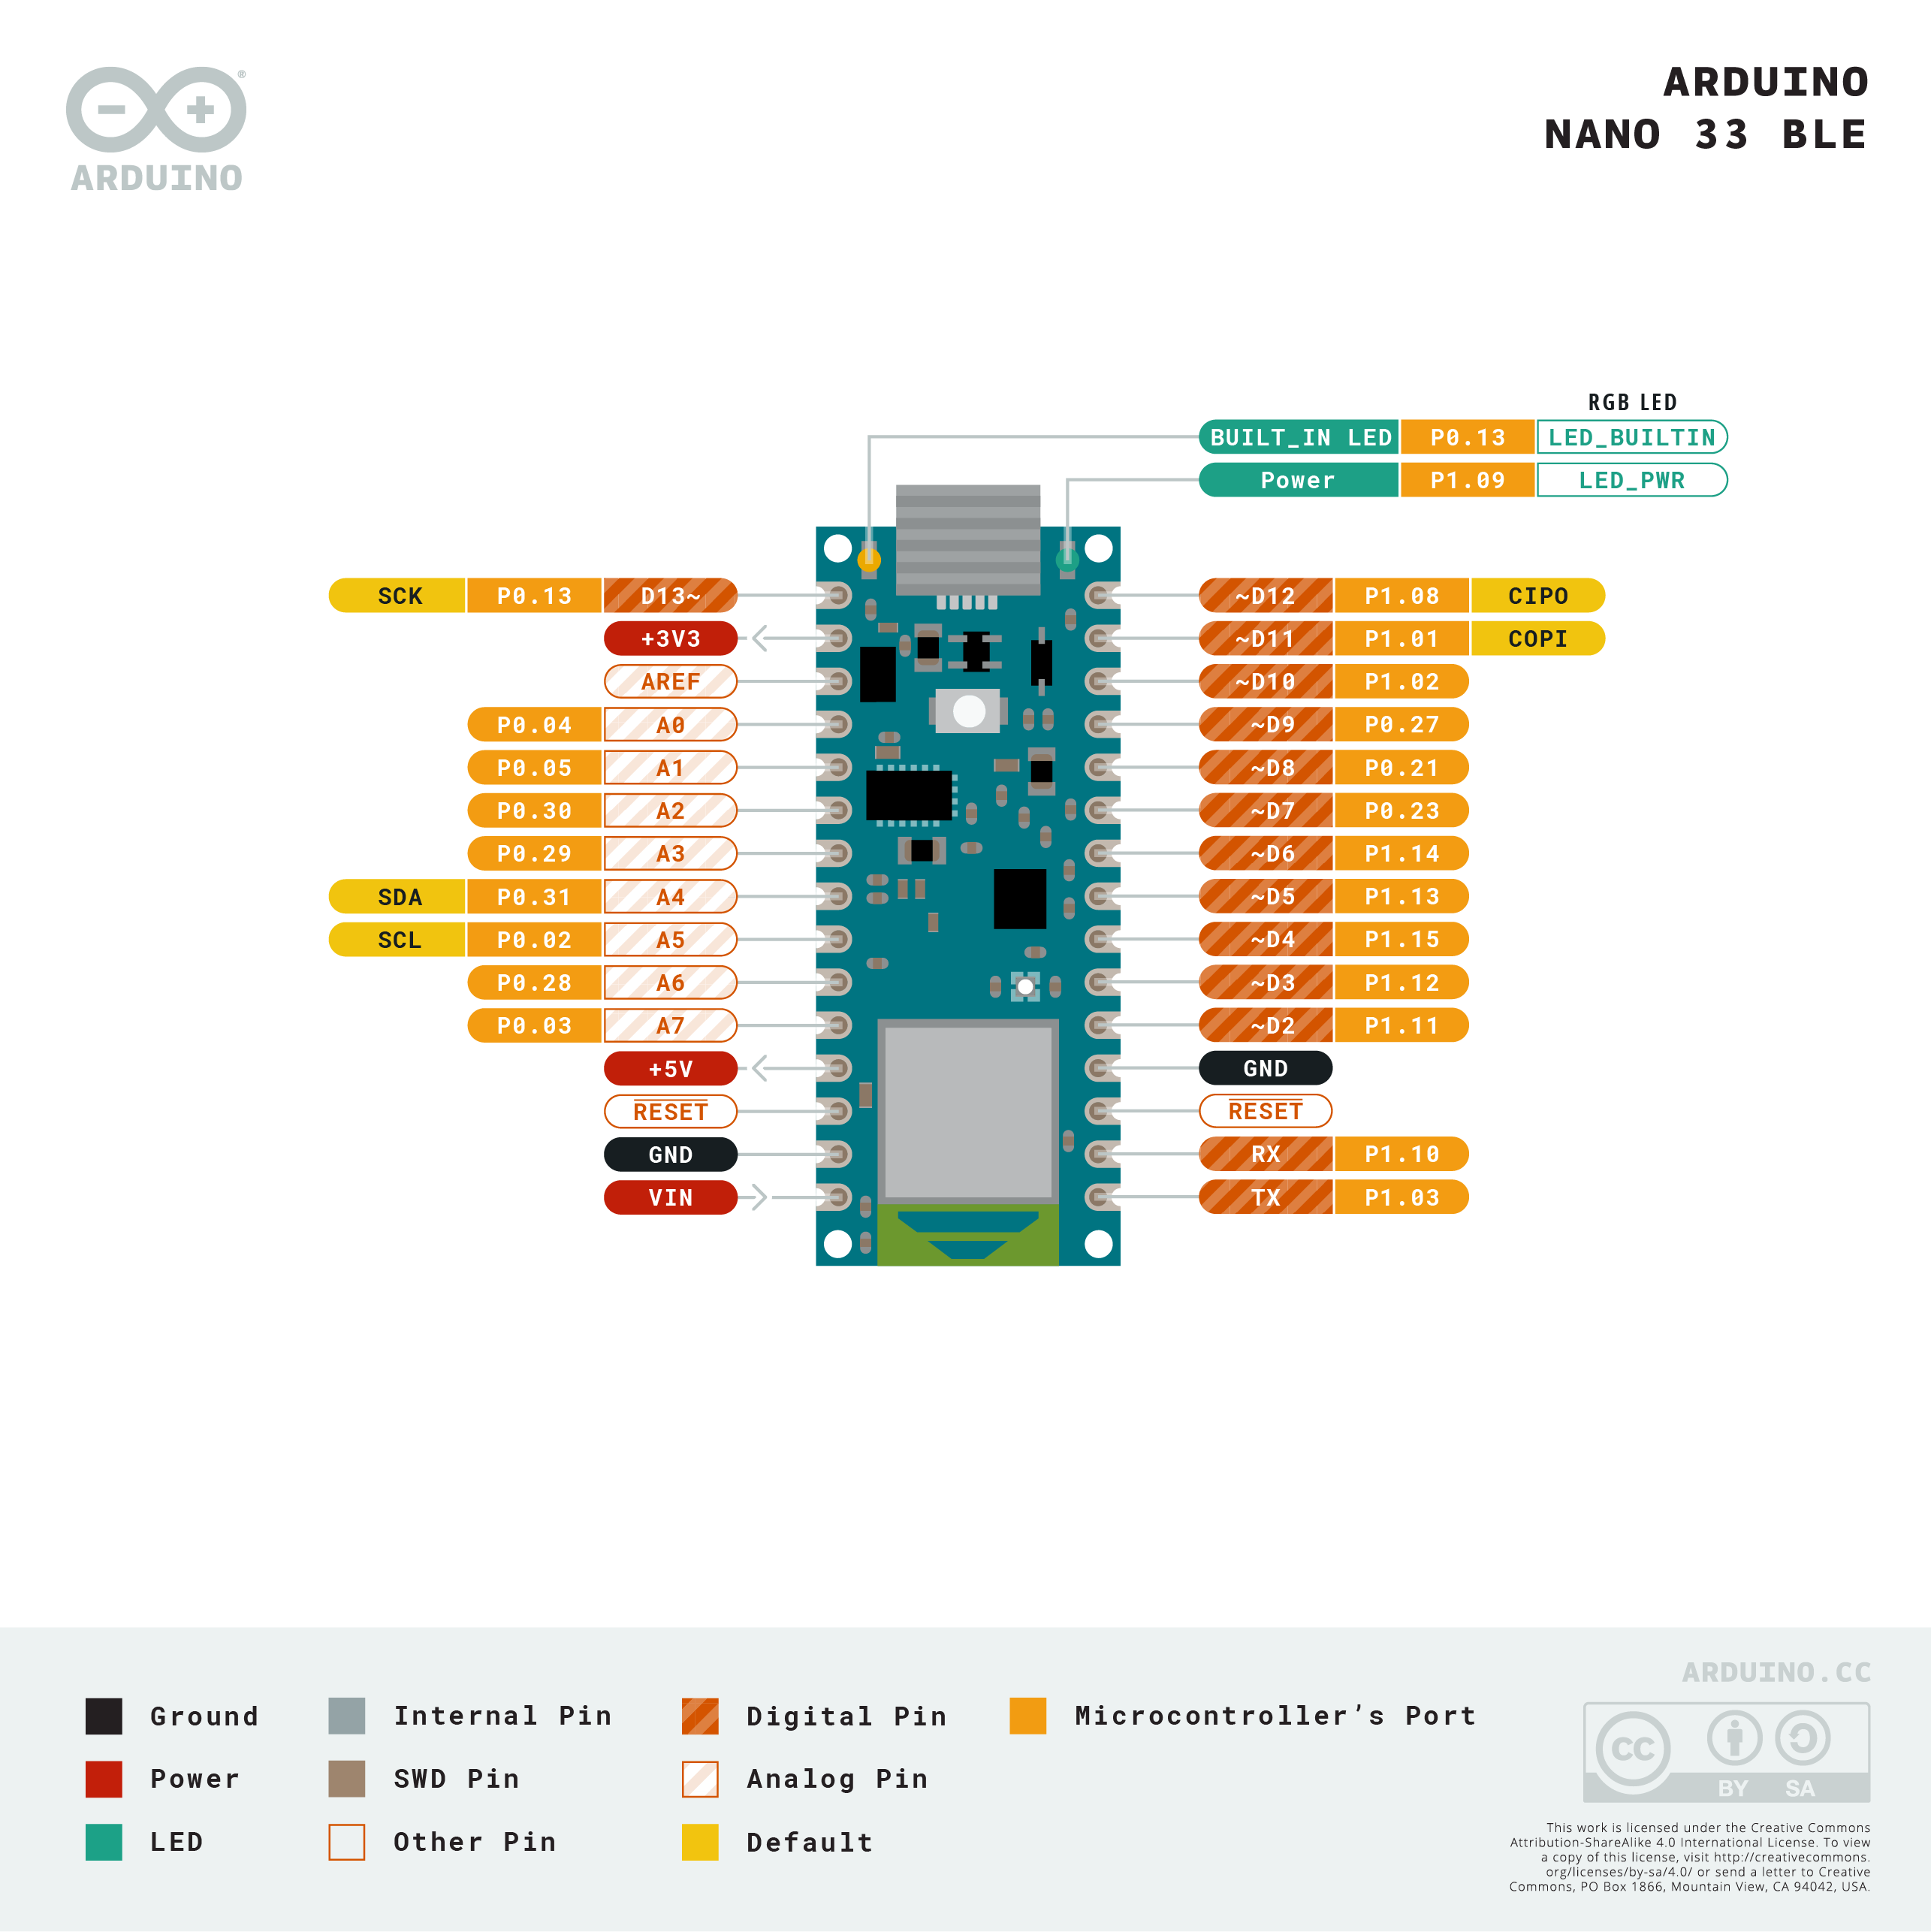
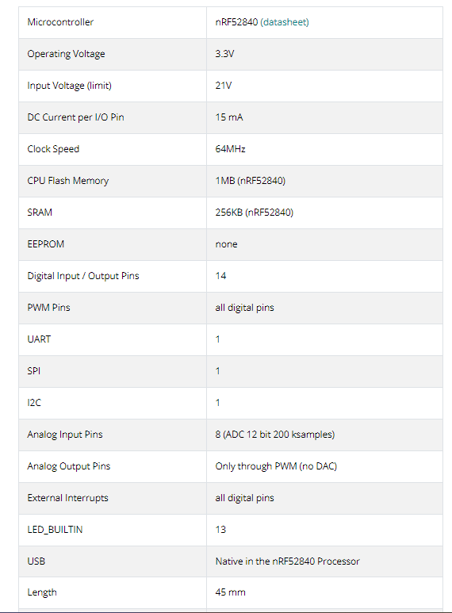

Slide 38
Get hexadecimal intensity values from Arduino Nano 33 BLE sense
Calculating histogram plot for an image
Converting intensity values into an RGB image
WORKFLOW:
Performing histogram equalization for an image

Slide 39
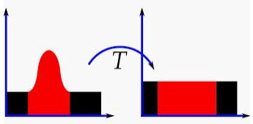
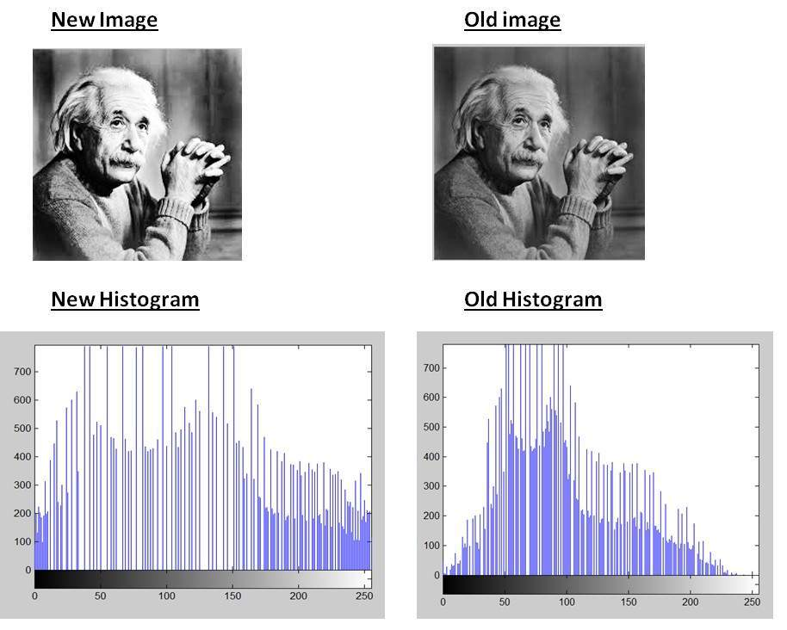
Histogram equalization
Histogram Equalization is a computer image processing technique used to improve contrast in images. It accomplishes this by effectively spreading out the most frequent intensity values, i.e. stretching out the intensity range of the image. This method usually increases the global contrast of images when its usable data is represented by close contrast values. This allows for areas of lower local contrast to gain a higher contrast.
Why Do You Use Histogram Equalization?
Histogram Equalization can be used when you have images that look washed out because they do not have sufficient contrast. In such photographs, the light and dark areas blend together creating a flatter image that lacks highlights and shadows. So, we use histogram equalization to overcome this problem.

Slide 40
We will be using the cv2.calcHist function to build our histograms. The function is:
cv2.calcHist(images, channels, mask, histSize, ranges)
Images: This is the image that we want to compute a histogram for.
Channels: A list of indexes, where we specify the index of the channel we want to compute a histogram for. To compute a histogram of a grayscale image, the list would be [0]
To compute a histogram for all three red, green, and blue channels, the channels list would be [0, 1, 2]
Mask: Well, here we can supply a mask. If a mask is provided, a histogram will be computed for masked pixels only. If we do not have a mask or do not want to apply one, we can just provide a value of None
histSize: This is the number of bins we want to use when computing a histogram. Again, this is a list, one for each channel we are computing a histogram for. The bin sizes do not all have to be the same. Here is an example of 32 bins for each channel: [32, 32, 32]
Ranges: The range of possible pixel values. Normally, this is [0, 256] (that is not a typo — the ending range of the cv2.calcHistfunction is non-inclusive so you’ll want to provide a value of 256 rather than 255)

Slide 41
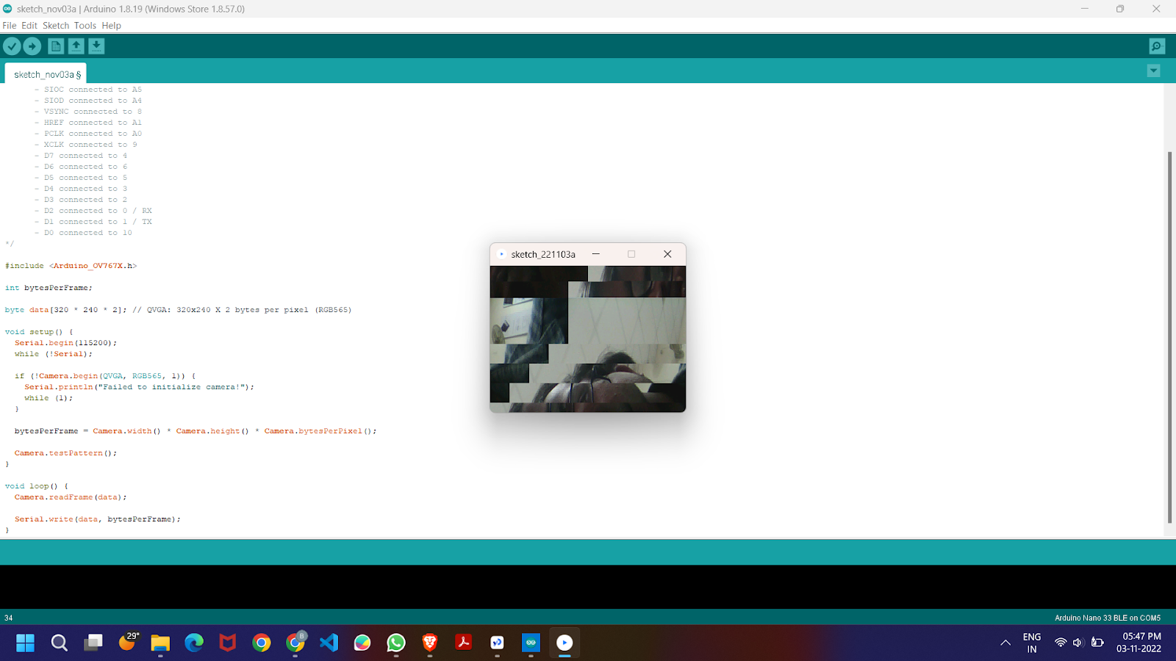
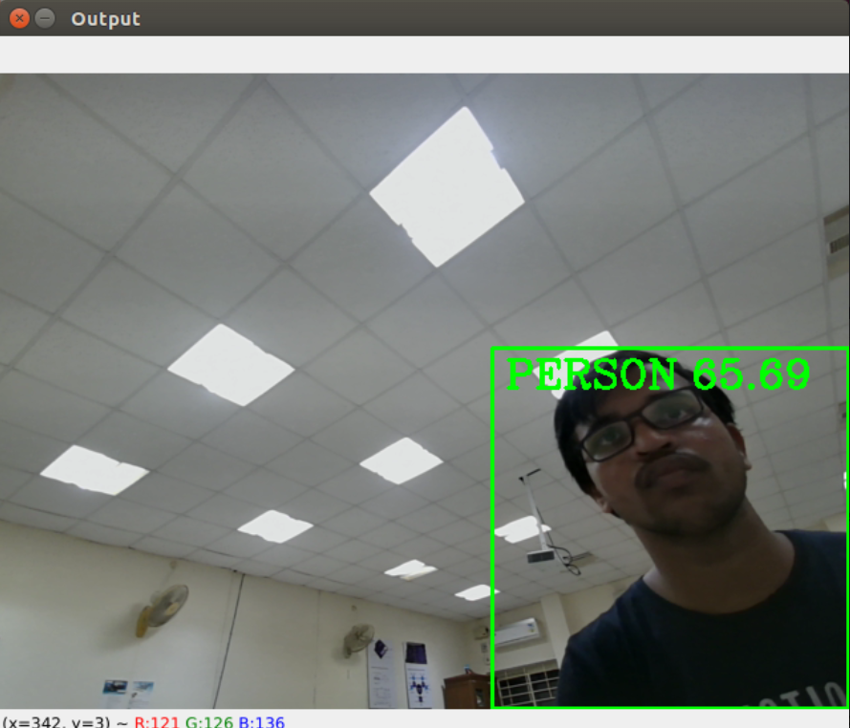
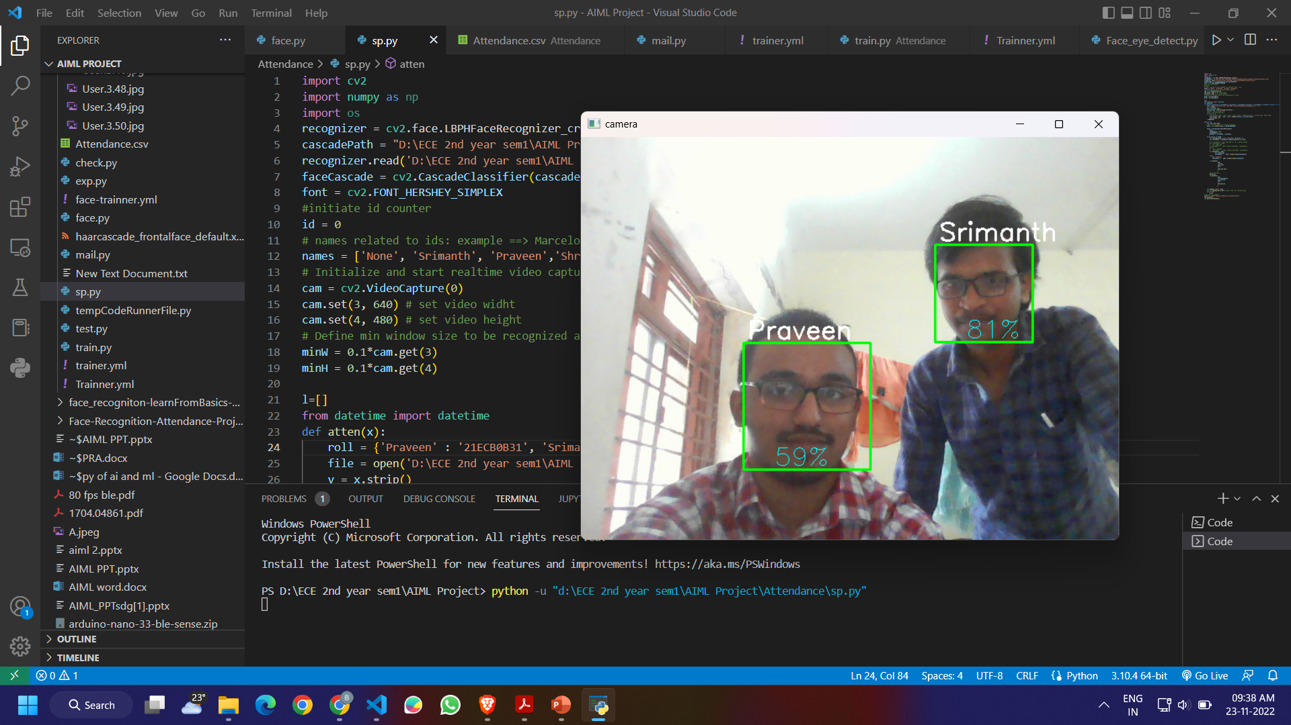
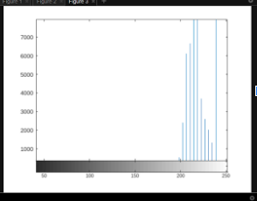
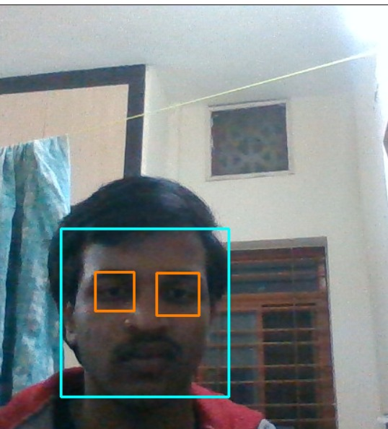
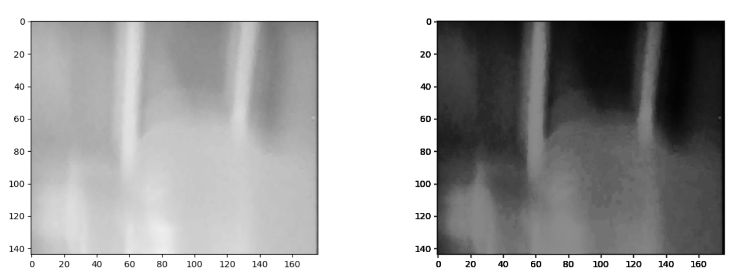
RESULTS:

Slide 42
FUTURE SCOPE:
The future work is to improve the recognition rate of algorithms when there are unintentional changes in a person like tonsuring head, using scarf, beard. The system developed only recognizes face upto 30 degrees angle variations which has to be improved further. Gait recognition can be fused with face recognition systems in order to achieve better performance of the system.
Our future work include to create an app for automatic attendance and implement it in our college and attendance will be captured and sent to corresponding professor .
We also want to do image processing using Arduino ble 33 sense.
We would like to do object detection and image classification on tiny ml devices like arduino nano ble33 sense and try to improve the accuracy and implement these on various algorithms and check.

Slide 43
REFERenceS
https://ieeexplore.ieee.org/stamp/stamp.jsp?tp=&arnumber=8463886
https://ieeexplore.ieee.org/stamp/stamp.jsp?tp=&arnumber=990517
https://www.ijert.org/research/object-detection-using-yolo-and-mobilenet-ssd-a-comparative-study-IJERTV11IS060065.pdf
https://www.researchgate.net/publication/316184205_MobileNets_Efficient_Convolutional_Neural_Networks_for_Mobile_Vision_Applications
https://www.sciencedirect.com/science/article/pii/S0144860921000753

Slide 44


